Slide 1
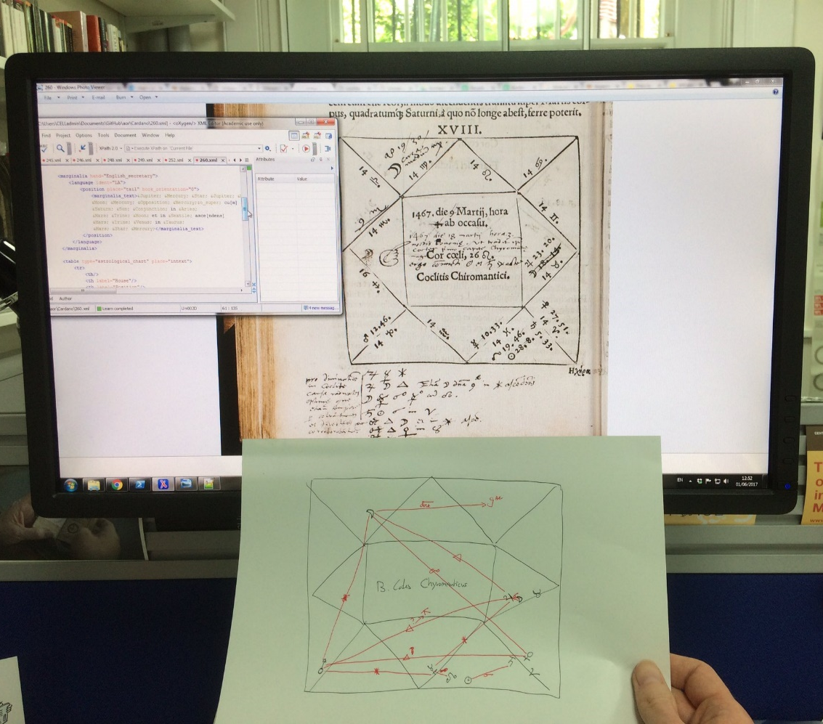
Scholarly Editions in the Digital Age
Dr. Jaap Geraerts
Dr. Jaap Geraerts, IEG DH Lab
Notes:
1

Slide 2
Content
Printed scholarly editions
Digital scholarly editions: characteristics
Digital scholarly editions: a practical example
The Archaeology of Reading in Early Modern Europe

Slide 3
Scholarly editions: a definition
“A scholarly edition is a representation of a historical textual document enhanced by the presence of a scholarly apparatus with the aim to make the represented object available for a wide audience and thus to further scholarship”

Slide 4
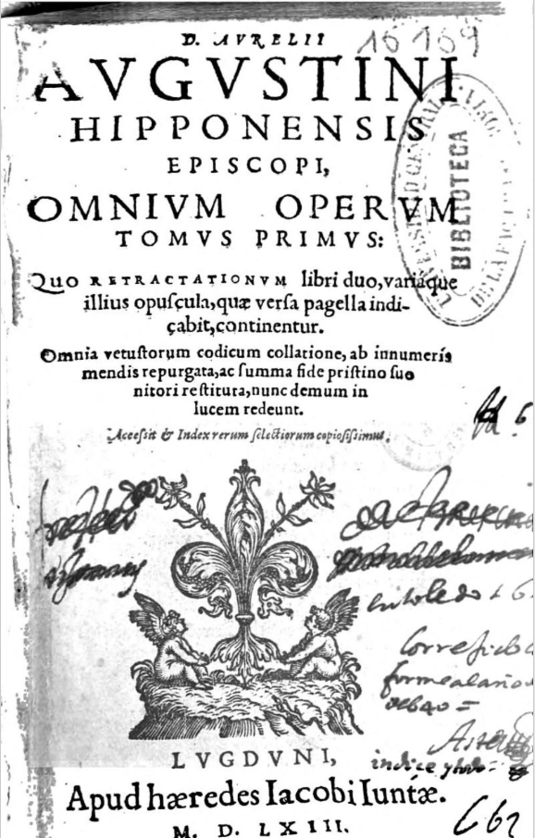
Printed scholarly editions
Making material accessible
to a larger audience
Bringing disparate
material together (corpus/corpora)
Establishing an authoritative
version/master text (Urtext)

Slide 5
Printed scholarly editions (2)
Editorial decisions
Which source(s) to use?
What to include/exclude?
Method of transcription
Translations?
Standardization (terms/concepts/names)

Slide 6
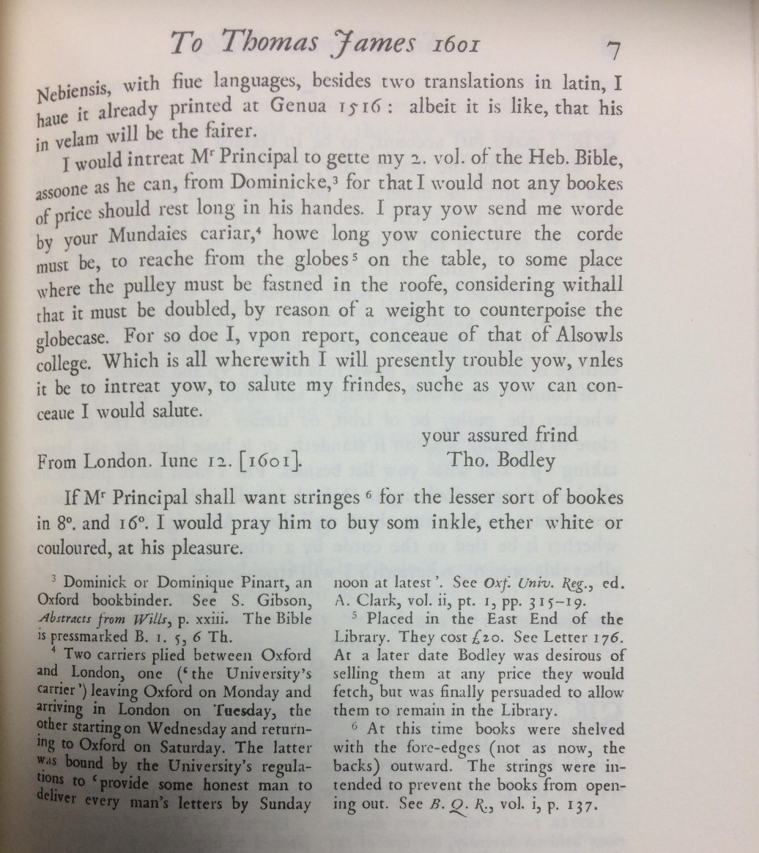
Printed scholarly editions (3)
Introductory essay
Text
Notes and/or annotations
Bibliography
Index or glossary
Possible illustrations
G.W. Wheeler (ed.), Letters of Sir
Thomas Bodley to Thomas James
(Oxford, 1975), p. 7.

Slide 7
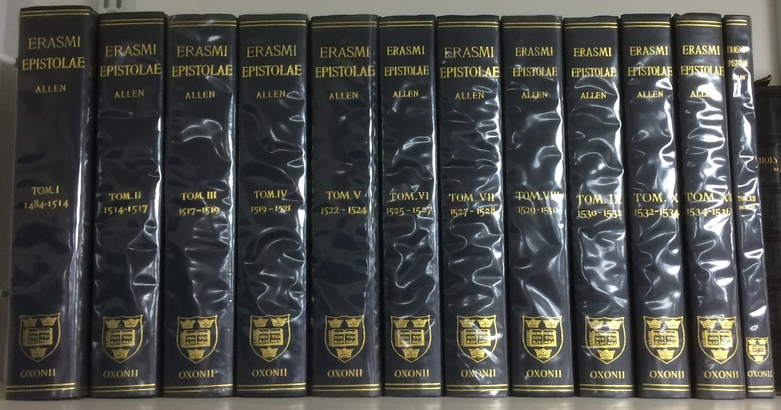
Printed scholarly editions (4)
Limitations
High costs of production
Constrained by physical size and limitation of printed book
Limited search possibilities (only TOC & index/glossary)
Cumbersome

Slide 8
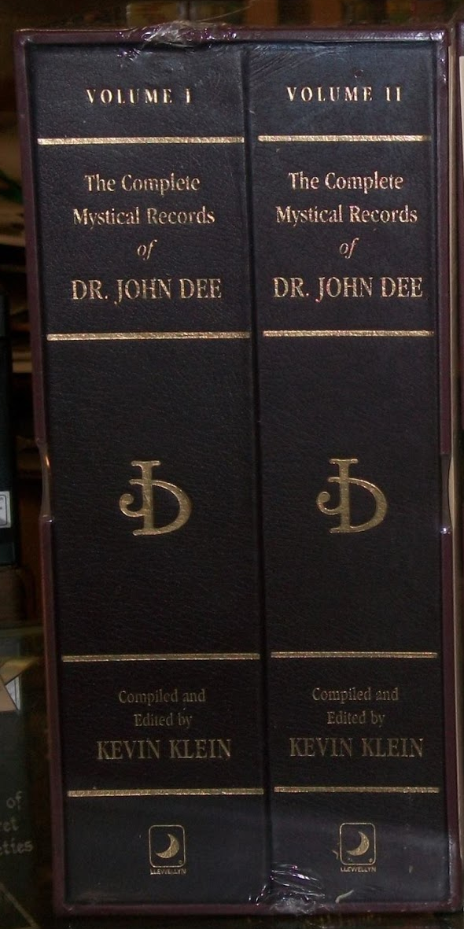
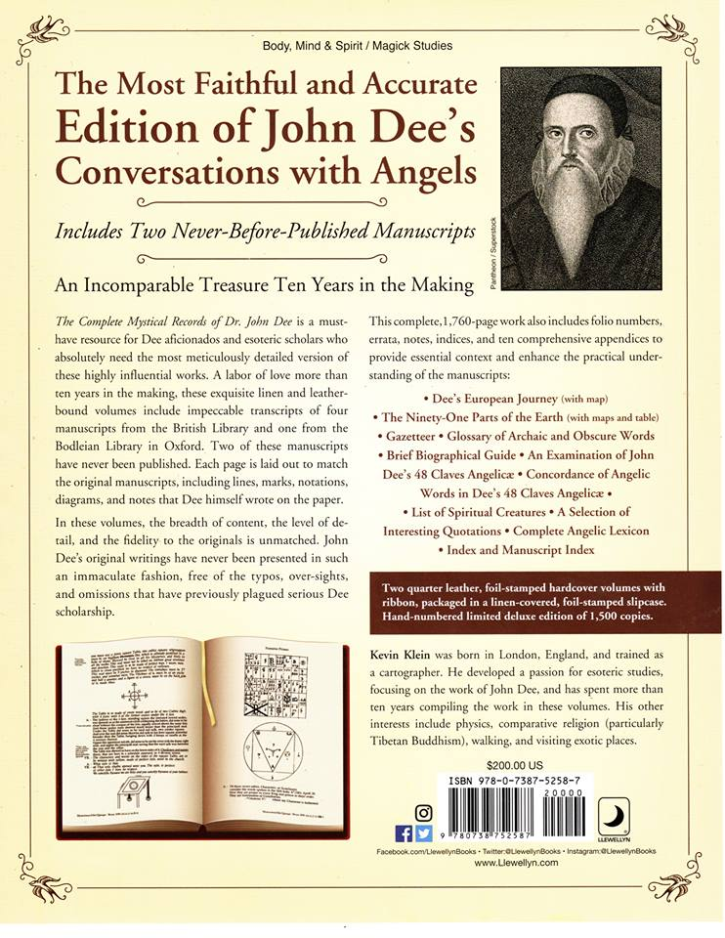
Slightly…mad?

Slide 9
Digital scholarly editions (1)
Digital edition ≠ digitized edition
Multiple versions of texts
Images of manuscripts, often interlinked with text
Use of pictures, sound, video, maps etc in explanatory notes
Multiple routes through the material (discoverability)
Easy to update?
No longer constrained by format of book or microfilm?
Foster wider participation e.g. crowdsourcing?
Rethinking processes associated with publication (e.g. peer review, open access publishing, reuse of material etc)

Slide 10
Hypertext & scholarly editions
Uses of Hypertext
Various ways to display text
Static <> dynamic
Integration of different types of media (text, image, etc)
Advantages of Hypertext
Associative rather than linear
Discoverability (search)
Non-linear and dynamic: multiple reading paths (applies to printed editions, too?)
Presentations not limited by physical aspects of printed object

Slide 11
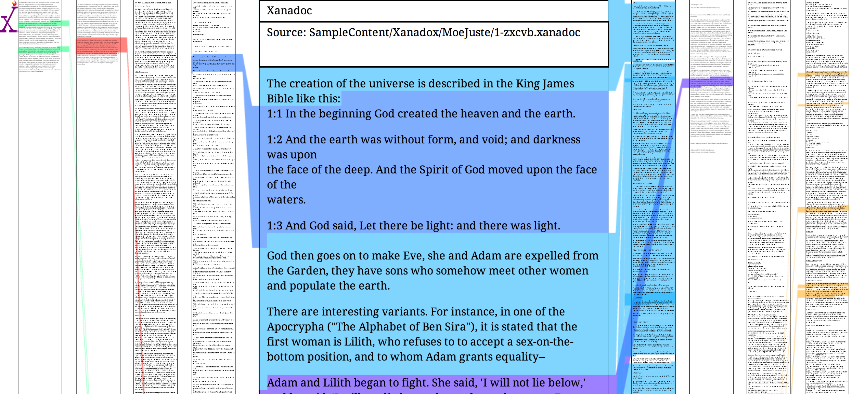
Ted Nelson‘s Xanadu
Source: https://kottke.org/14/06/pioneering-hypertext-project-xanadu-released-after-54-years

Slide 12
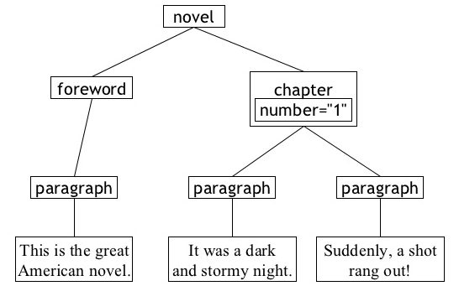
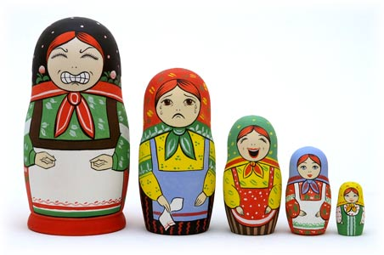
XML and digital editions
eXtensible Markup Language
Used to capture data (key difference with HTML)
Classification of data (hierarchy)
Making possible complex searches

Slide 13
Hallmarks of scholarly digital editions
Source(s) indicated
Description of transcription philosophy and editorial processes used
Use non-proprietary software and open standards (?)
Interoperability (?)
Preservation and sustainability plan in place (?)
Allow questions that are otherwise impossible or very difficult to ask to be explored (?)
Data export and reuse?
See MLA Guidelines for Editors of Scholarly Editions
Overview: http://www.digitale-edition.de/vlet_early_m.html

Slide 14
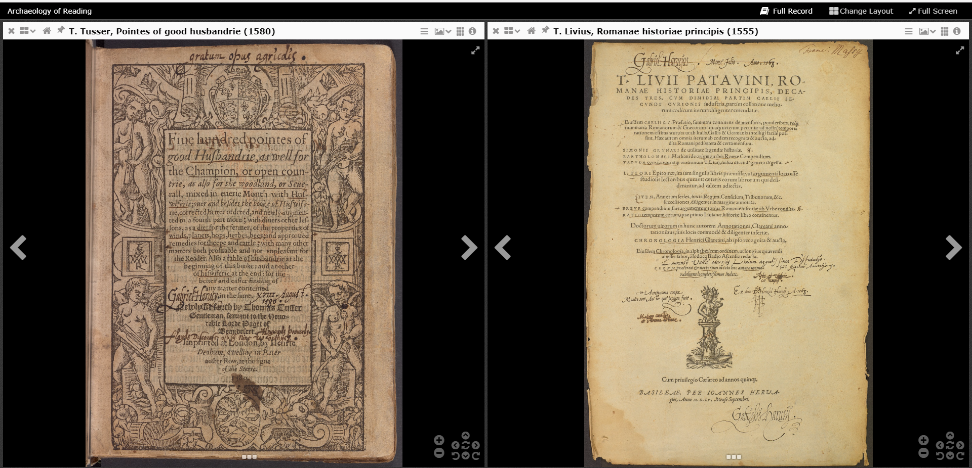
Digital scholarly editions (2)
Possible disadvantages of digital scholarly editions
Loss of (awareness of) physical qualities of source material
“Going down the rabbit hole” – where am I (navigation)?
How to reconstruct reading paths (and links created by user)?
Constrained by format (screen size, etc)?
Usability (GUI, search engine)
Stability & accessibility of resource
(maintenance)

Slide 15
The Archaeology of Reading (AOR)
AOR
Five-year digital humanities project (2014-9)
Funded by the Andrew W. Mellon Foundation
International collaboration between CELL, Johns Hopkins University, and Princeton University
History of reading
Focus on two known readers: Gabriel Harvey and John Dee
Corpus of 35 early modern annotated books

Slide 16
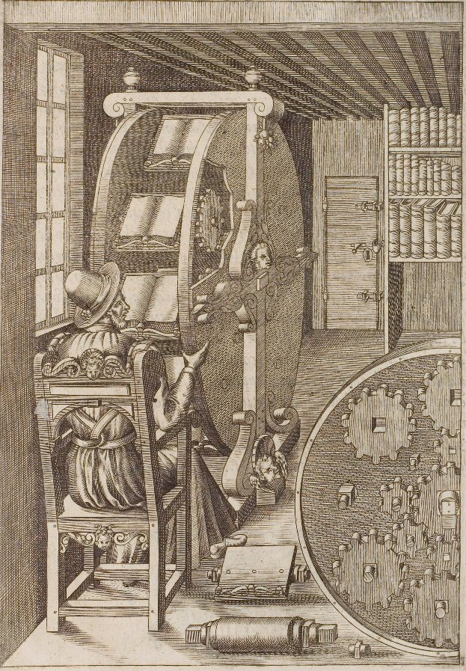
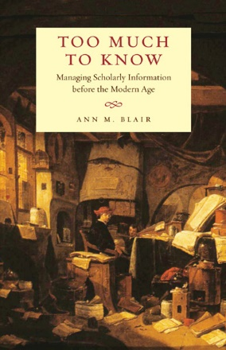
AOR (2)
Bespoke XML schema (no TEI)
Modified IIIF viewer
Digital images and transcription:
no need for formal edition
Transcriber’s Manual (100+ pages)
Aims: discoverability through search, reconstructing
reader’s pathways & their reading strategies
Early modern readers also dealt with
information overload!

